Slide 1
Annualized Sharpe Momentum Strategy
Daniyal Bekinalkar

Slide 2
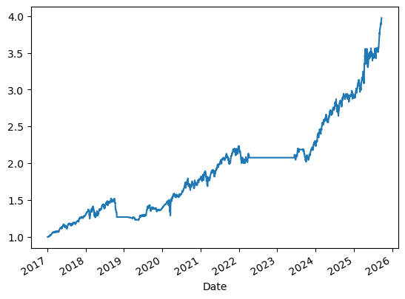
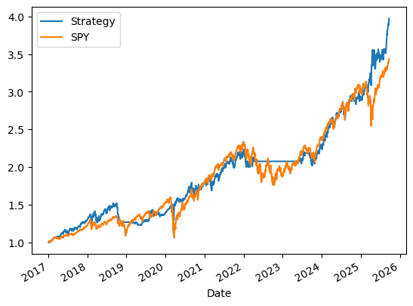
Final Strategy

Slide 3
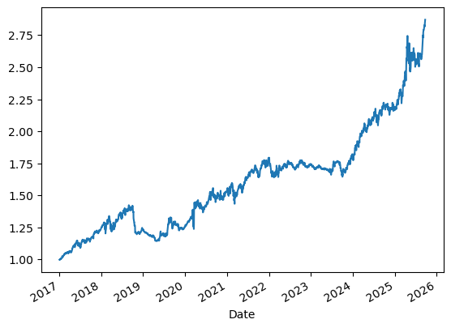
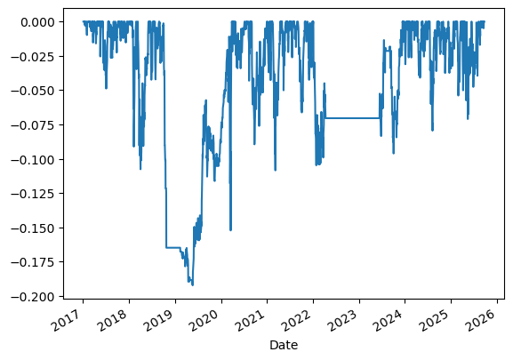
Stats
Net Profit: 2.974015654119825
Gross Profit: 6.7802211071687815
Gross Loss: 5.319087104654649
Max Drawdown: -0.1923726699933178
Max Drawdown Duration: 488 days
Annualized Volatility: 0.1364296899243756

